Slide 1

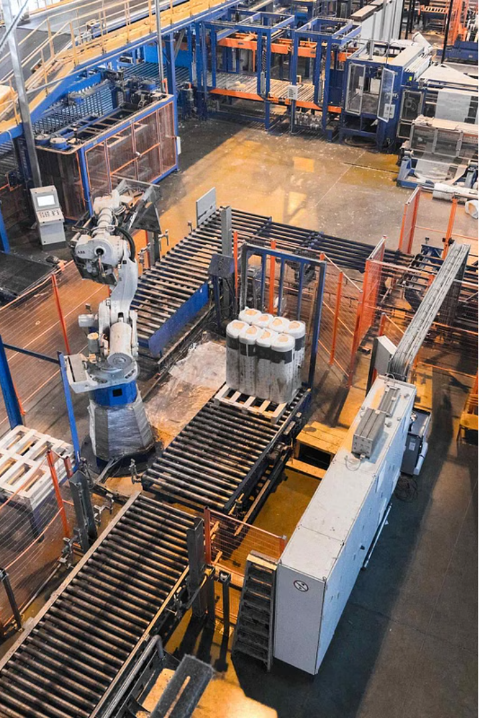

LEAN SYSTEM IN INDUSTRIAL AND OPERATIONS MANAGEMENT

Slide 2

Presented By:
Leader : Maheru Tabassum Ohona
ID: 2125051015
Md. Mahedi Hasan
ID: 2125051003
Md. Shariful Islam Sajib Sarker
ID: 2125051016
Md. Sowrob Bhuiyan
ID:2125051026
Mofidul Haque Nibir
ID: 2125051020
Md. Saiful Islam Santo
ID: 2125051047
Presented To:
Md. Nasim Chowdhury
Lecturer, Dept. Of Business Studies, UITS

Slide 3

Introduction
Welcome to our presentation on Lean System in Industrial and Operations Management. Today, we'll delve into the fundamental principles and practical applications of Lean methodologies in optimizing industrial processes. Lean system is a revolutionary management approach that focuses on maximizing customer value while minimizing waste. It originated in the Toyota Production System and has since been adopted by organizations worldwide to drive efficiency, quality, and continuous improvement.

Slide 4
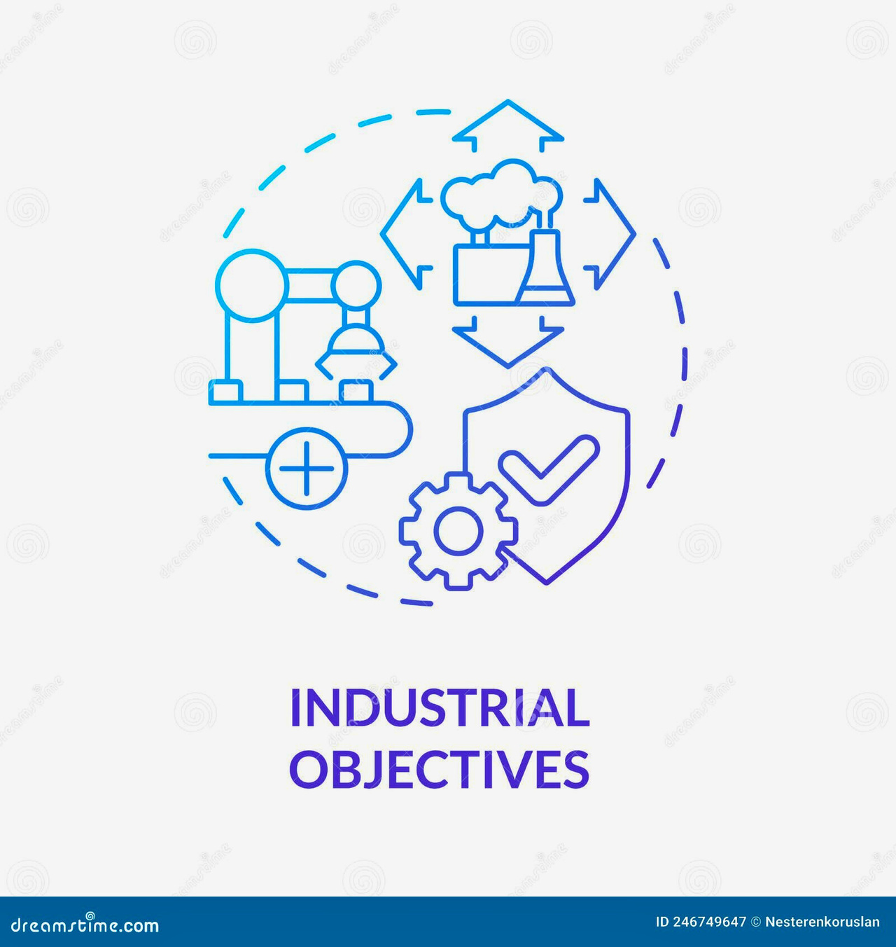
Objective
Understanding the Lean Methodology
Core Principles of Lean
Applying Lean to Process Management
Implementing Lean in Supply Chains
The Kanban System
Key Elements of the Kanban System
Continuous Improvement with Lean
Benefits of Lean System

Slide 5
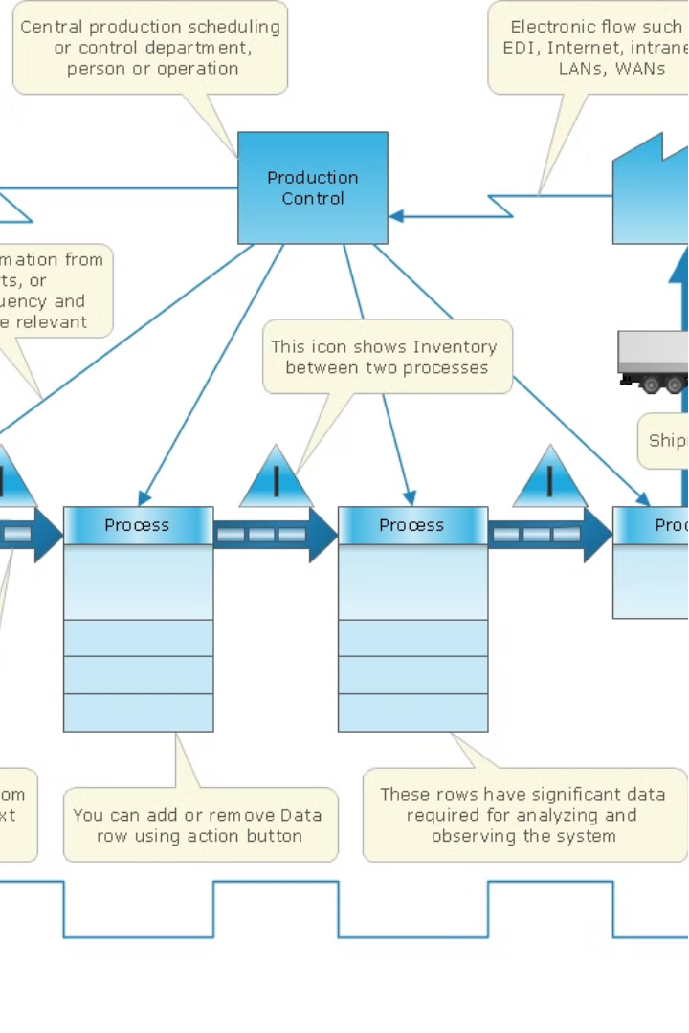
Understanding the Lean Methodology
Lean is a transformative management approach that focuses on eliminating waste, optimizing processes, and continuously improving efficiency. At its core, Lean emphasizes the relentless pursuit of perfection by empowering employees, fostering a culture of collaboration, and delivering exceptional value to customers.
By adopting Lean principles, organizations can streamline operations, reduce cycle times, and enhance product quality. The methodology encourages data-driven decision making, just-in-time production, and a deep understanding of customer needs to drive sustainable growth.

Slide 6
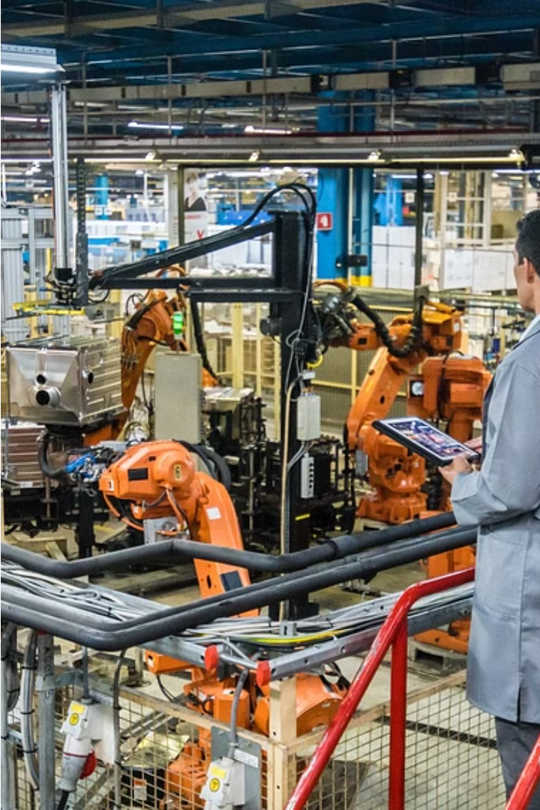
Core Principles of Lean
Value: Identify customer needs and focus on delivering value.
Value Stream: Map processes to identify value-adding steps and eliminate waste.
Flow: Ensure smooth flow of work to minimize delays and interruptions.
Pull: Produce based on customer demand to reduce inventory and overproduction.
Perfection: Continuously improve processes to strive for perfection.
Respect for People: Lean empowers employees, fostering a collaborative environment where their input and expertise are highly valued.
Just-in-Time Production: Lean optimizes inventory and production, delivering products only when customers demand them to minimize waste.

Slide 7
Other Principles of Lean System
Standardization:
Respect for Employees:
Elimination of Waste :
1
2
3
Establish standardized work processes and procedures.
Define clear standards and best practices for performing tasks.
Ensure consistency and quality in all operations.
Lean values the knowledge and capabilities of employees, empowering them to identify and resolve issues.
Lean aims to eliminate all forms of waste, including overproduction, waiting, transportation, and defects.

Slide 8
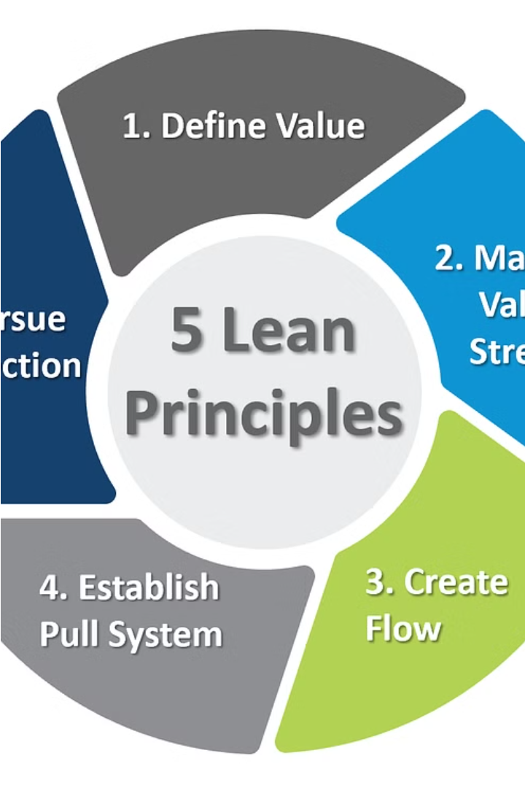
Key Elements of Lean System
5S Methodology: Sort, Set in order, Shine, Standardize, Sustain - Organize workplace for efficiency and safety.
Just-in-Time (JIT): Produce goods or services only as needed, minimizing inventory and storage costs.
Kanban System: Visualize workflow, limit work in progress, and facilitate continuous improvement.
Total Productive Maintenance (TPM): Maintain equipment to prevent breakdowns and ensure optimal performance.
Kaizen: Foster a culture of continuous improvement by involving employees in problem-solving and innovation.

Slide 9
Key Elements of Lean System
Empowerment
Standardized Work
Visual Management
Engage employees at all levels in the improvement process.
Empower employees to take ownership of their work and contribute to organizational success.
Establishing consistent processes and procedures to ensure quality and efficiency.
Ensure consistency and quality in all operations.
Using visual cues and displays to provide transparency and control over operations.

Slide 10
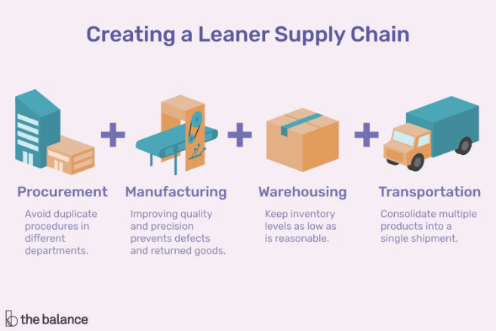
Implementing Lean in Supply Chains
Lean principles can revolutionize supply chain management by eliminating waste, optimizing inventory, and streamlining logistics. By applying Just-In-Time (JIT) production and Kanban systems, organizations can achieve responsive, agile, and efficient supply chain operations.
Leveraging data-driven insights, Lean empowers supply chain leaders to identify and address bottlenecks, reduce lead times, and enhance overall supply chain visibility and responsiveness.

Slide 11

Implementation Strategies
Assess Readiness
Comprehensive Training
Evaluate the organization's culture, processes, and leadership commitment to Lean.
Equip employees at all levels with the knowledge and skills to embrace Lean principles.
1
2
3
Pilot Projects
Implement Lean in targeted areas to demonstrate its benefits and build momentum.

Slide 12

The Kanban System
Kanban is a visual workflow management system that helps organizations optimize their processes and achieve just-in-time production. By utilizing Kanban boards and cards, teams can enhance transparency, identify bottlenecks, and continuously improve their workflows.

Slide 13

Key Elements of the Kanban System
1.Visualization: Kanban utilizes visual boards and cards to make workflows, tasks, and progress highly transparent across the organization.
2.Work-in-Progress (WIP) Limits: Kanban enforces strict limits on the amount of work that can be in progress at any given time, preventing overproduction and identifying bottlenecks.
3.Pull-Based System: Kanban operates on a pull-based model, where new work is only pulled into the system when there is available capacity, minimizing waste.
4.Continuous Improvement: Kanban encourages teams to frequently inspect and adapt their processes, driving continuous optimization and eliminating inefficiencies.

Slide 14
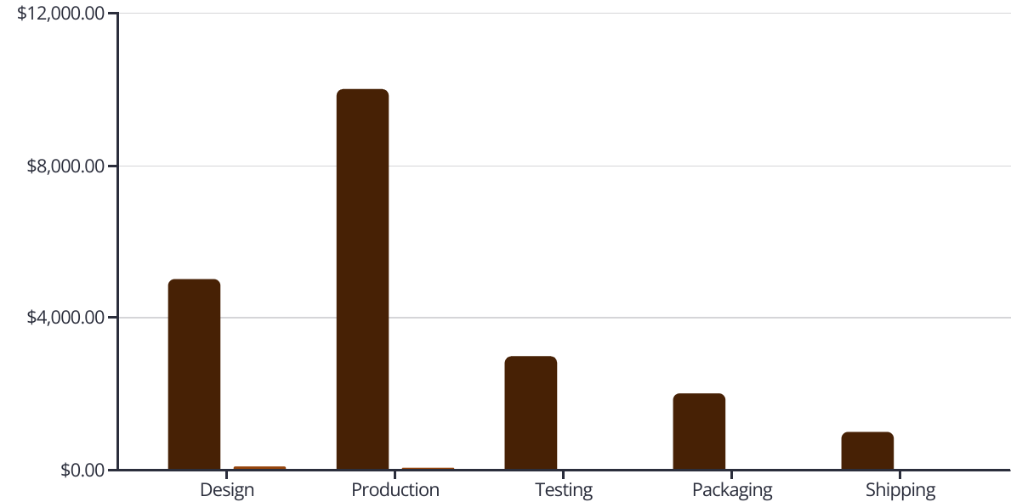
Visualizing and Controlling Workflow
Cycle Time
Defects
By visualizing key workflow metrics like cycle time and defect rates, Lean teams can pinpoint opportunities for improvement and take targeted action to enhance process efficiency and quality. This data-driven approach allows organizations to proactively manage and optimize their operations.

Slide 15

Continuous Improvement with Lean
1
Kaizen Mindset
Lean embraces a culture of continuous improvement, where employees at all levels are empowered to identify and implement small, incremental enhancements to processes and workflows on an ongoing basis.
2
Customer Feedback
Lean organizations closely monitor customer feedback and use those insights to drive continuous refinement of products, services, and processes, ensuring they remain responsive to evolving customer needs.
3
Data-Driven Decisions
Lean relies on data and metrics to measure performance, track progress, and inform decision-making, enabling organizations to make well-informed, targeted improvements with measurable impact.

Slide 16
Challenges and Considerations in Lean Adoption
Cultural Shift
Leadership Commitment
Training and Upskilling
Measuring Impact
Implementing Lean requires a fundamental change in organizational culture, where continuous improvement and employee empowerment become the norm. Resistance to change can be a significant hurdle to overcome.
Successful Lean transformations require unwavering support and commitment from senior leadership. Without buy-in at the top, Lean initiatives often struggle to gain traction throughout the organization.
Equipping employees with the necessary skills and knowledge to apply Lean principles is crucial. Comprehensive training programs help foster a Lean mindset and empower teams to drive continuous improvement.
Quantifying the benefits of Lean can be challenging, as the improvements may not always be immediately visible. Establishing robust metrics and KPIs is essential to demonstrate the tangible impact of Lean initiatives.

Slide 17
Role of Leadership in Lean System
Leadership plays a crucial role in implementing lean systems within an organization.
Therefore, which includes:
1. Vision Setting
2. Change Management
3. Commitment
4. Empowerment
5. Resource Allocation
6. Measurement and Feedback
7. Role Modeling

Slide 18
Benefits of Lean System
Improved Efficiency
Enhanced Quality
Lean reduces waste and non-value-added activities, leading to increased productivity and throughput.
Lean emphasizes defect prevention and continuous improvement, resulting in higher-quality products and services.
Cost Savings
Waste Reduce
By eliminating waste and optimizing processes, Lean can significantly reduce operational costs.
Lean systems are designed to be responsive to changing customer demands and Eliminating waste lowers costs.

Slide 19
Conclusion
Lean system is a powerful management approach that can transform organizations by enhancing efficiency, quality, and customer satisfaction. By embracing Lean principles and implementing effective strategies, businesses can achieve sustainable competitive advantage and long-term success.

Slide 20
Thank You
For your attention

Slide 21

Any Questions?

